Slide 1
IB2d Practical

Slide 2
Rubber band example
In this example, a rubber band is initially deformed and resists stretching but not bending.
You can run a low resolution example.
MATLAB - matIB2d/Examples/Example_Standard_Rubberband/Rubberband_with_Springs
Navigate to the folder and simply type the following in the command window
> main2d

Slide 3
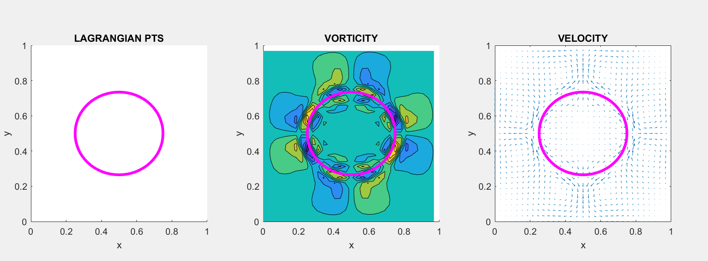
Running the simulation
A MATLAB window will pop up that shows a rubber band oscillating in a fluid.

Slide 4
Associated files
main2d is the function that gets called to run the code. It itself, reads in parameters from the input2d file, and passes them to the IBM_Driver function to run the simulation
Rubberband.m creates the RUBBERBAND-EXAMPLE geometry and prints associated input files. Note: In other examples this is sometimes called generate_mesh.m
input2d is where you set the physical parameters (density, viscosity, etc) grid size, temporal information, which elastic models are used, etc.

Slide 5
Rubberband / Generate_mesh files
This file is simply used to generate the .vertex and .spring, files. In other examples it might create .mass, .beam, etc. files.
You could write your own function for doing this in MATLAB, Python, or any other programming language.
If you modify the boundary, elastic files, grid sized, etc., you will need to run this file to make new .vertex and .spring.

Slide 6
Rubberband.m
function Rubberband()
%
% Grid Parameters (MAKE SURE MATCHES IN input2d !!!)
%
Nx = 32; % # of Eulerian Grid Pts. in x-Direction (MUST BE EVEN!!!)
Ny = 32; % # of Eulerian Grid Pts. in y-Direction (MUST BE EVEN!!!)
Lx = 1.0; % Length of Eulerian Grid in x-Direction
Ly = 1.0; % Length of Eulerian Grid in y-Direction
% Immersed Structure Geometric / Dynamic Parameters %
N = 2*Nx; % Number of Lagrangian Pts. (2x resolution of Eulerian grid)
a = 0.4; % Length of semi-major axis.
b = 0.2; % Length of semi-minor axis.
ds_Rest = 0; % Resting length of springs
struct_name = 'rubberband'; % Name for .vertex, .spring, etc files.
% Call function to construct geometry
[xLag,yLag] = give_Me_Immsersed_Boundary_Geometry(N,a,b);
% Plot Geometry to test
plot(xLag,yLag,'r-'); hold on;
plot(xLag,yLag,'*'); hold on;
xlabel('x'); ylabel('y');
axis square;
% Prints .vertex file!
print_Lagrangian_Vertices(xLag,yLag,struct_name);
% Prints .spring file!
k_Spring = 2.5e4;
print_Lagrangian_Springs(xLag,yLag,k_Spring,ds_Rest,struct_name);
The start of the file sets the domain size, spatial step size, geometry of the rubber band, etc.

Slide 7
Rubberband.m .vertex
%%%%%%%%%%%%%%%%%%%%%%%%%%%%%%%%%%%%%%%%%%%%%%%%%%%%%%%%%%%%%%%%%%%%%%%%
%
% FUNCTION: prints VERTEX points to a file called rubberband.vertex
%
%%%%%%%%%%%%%%%%%%%%%%%%%%%%%%%%%%%%%%%%%%%%%%%%%%%%%%%%%%%%%%%%%%%%%%%%
function print_Lagrangian_Vertices(xLag,yLag,struct_name)
N = length(xLag);
vertex_fid = fopen([struct_name '.vertex'], 'w');
fprintf(vertex_fid, '%d\n', N );
%Loops over all Lagrangian Pts.
for s = 1:N
X_v = xLag(s);
Y_v = yLag(s);
fprintf(vertex_fid, '%1.16e %1.16e\n', X_v, Y_v);
end
fclose(vertex_fid);
This function creates the .vertex file that gives the total number of vertices and then the list of x,y coordinates.

Slide 8
rubberband.vertex
64
6.9999999999999996e-01 5.0000000000000000e-01
6.9903694533443939e-01 5.3920685613182429e-01
6.9615705608064604e-01 5.7803612880645128e-01
6.9138806714644174e-01 6.1611387090178493e-01
6.8477590650225739e-01 6.5307337294603596e-01
6.7638425286967108e-01 6.8855869473039910e-01
6.6629392246050911e-01 7.2222809320784087e-01
6.5460209067254738e-01 7.5375731366545828e-01
6.4142135623730956e-01 7.8284271247461901e-01
6.2687865683272914e-01 8.0920418134509475e-01
6.1111404660392044e-01 8.3258784492101812e-01
5.9427934736519961e-01 8.5276850573934193e-01
5.7653668647301792e-01 8.6955181300451478e-01
5.5805693545089241e-01 8.8277613429288360e-01
5.3901806440322564e-01 8.9231411216129219e-01
5.1960342806591220e-01 8.9807389066887877e-01
5.0000000000000000e-01 9.0000000000000002e-01
…………
There are 64 vertices. The rows that follow give the x,y coordinates.

Slide 9
Rubberband.m .spring
%%%%%%%%%%%%%%%%%%%%%%%%%%%%%%%%%%%%%%%%%%%%%%%%%%%%%%%%%%%%%%%%%%%%%%%%
%
% FUNCTION: prints SPRING points to a file called rubberband.spring
%
%%%%%%%%%%%%%%%%%%%%%%%%%%%%%%%%%%%%%%%%%%%%%%%%%%%%%%%%%%%%%%%%%%%%%%%%
function print_Lagrangian_Springs(xLag,yLag,k_Spring,ds_Rest,struct_name)
N = length(xLag);
spring_fid = fopen([struct_name '.spring'], 'w');
fprintf(spring_fid, '%d\n', N );
%spring_force = kappa_spring*ds/(ds^2);
%SPRINGS BETWEEN VERTICES
for s = 1:N
if s < N
fprintf(spring_fid, '%d %d %1.16e %1.16e\n', s, s+1, k_Spring, ds_Rest);
else
%Case s=N
fprintf(spring_fid, '%d %d %1.16e %1.16e\n', s, 1, k_Spring, ds_Rest);
end
end
fclose(spring_fid);
This function creates the .spring file. The total number of springs is given, the nodes that are connected, the spring constant, and resting length.

Slide 10
rubberband.spring
64
1 2 2.5000000000000000e+04 0.0000000000000000e+00
2 3 2.5000000000000000e+04 0.0000000000000000e+00
3 4 2.5000000000000000e+04 0.0000000000000000e+00
4 5 2.5000000000000000e+04 0.0000000000000000e+00
5 6 2.5000000000000000e+04 0.0000000000000000e+00
6 7 2.5000000000000000e+04 0.0000000000000000e+00
7 8 2.5000000000000000e+04 0.0000000000000000e+00
8 9 2.5000000000000000e+04 0.0000000000000000e+00
9 10 2.5000000000000000e+04 0.0000000000000000e+00
10 11 2.5000000000000000e+04 0.0000000000000000e+00
11 12 2.5000000000000000e+04 0.0000000000000000e+00
12 13 2.5000000000000000e+04 0.0000000000000000e+00
13 14 2.5000000000000000e+04 0.0000000000000000e+00
14 15 2.5000000000000000e+04 0.0000000000000000e+00
15 16 2.5000000000000000e+04 0.0000000000000000e+00
16 17 2.5000000000000000e+04 0.0000000000000000e+00
17 18 2.5000000000000000e+04 0.0000000000000000e+00
……….
There are 64 springs. They are connected to nodes 1 and 2, 2 and 3, 3 and 4, etc. The spring stiffnesses are 2.5e04, and their resting lengths are zero.

Slide 11
Using Visit Visualization
If you don’t have Visit, download the latest version here: https://visit-dav.github.io/visit-website/releases-as-tables/#series-34
Notice that when you run a simulation, two folders are created called hier_IB2d_data and viz_IB2d.
The hier folder includes information about the forces acting on the nodes.
The viz_IB2d folder includes flow field data and the x,y-coordinates of the vertices.

Slide 12
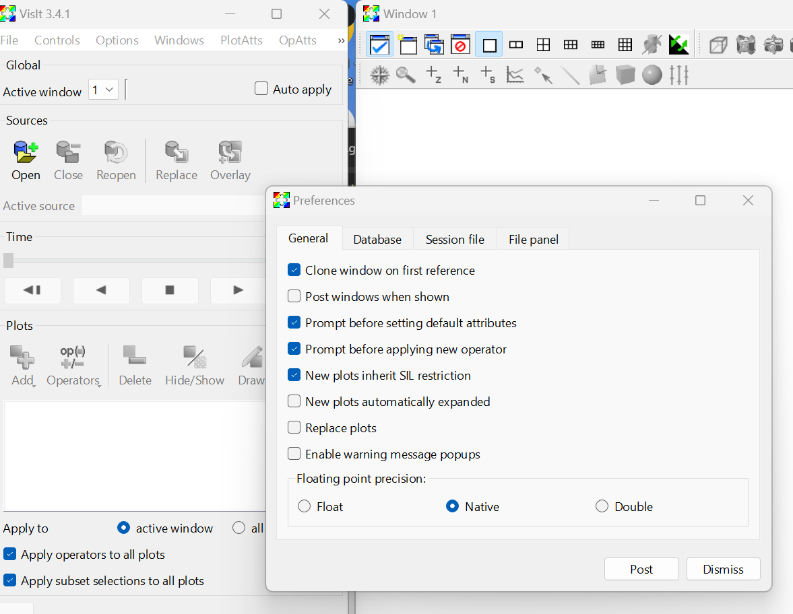
Set some preferences
Next click on the Visit 3.4.1 next to File and click on Preferences, or click on Options and then Preferences. UNCHECK the box that reads Enable Warning Message Popups. (The reason for this is because when we start saving movies, a pop-up will spring up every time-step, which quite frankly can gets rather annoying).

Slide 13
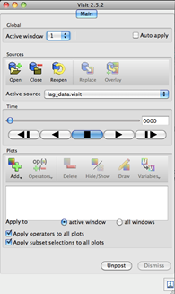
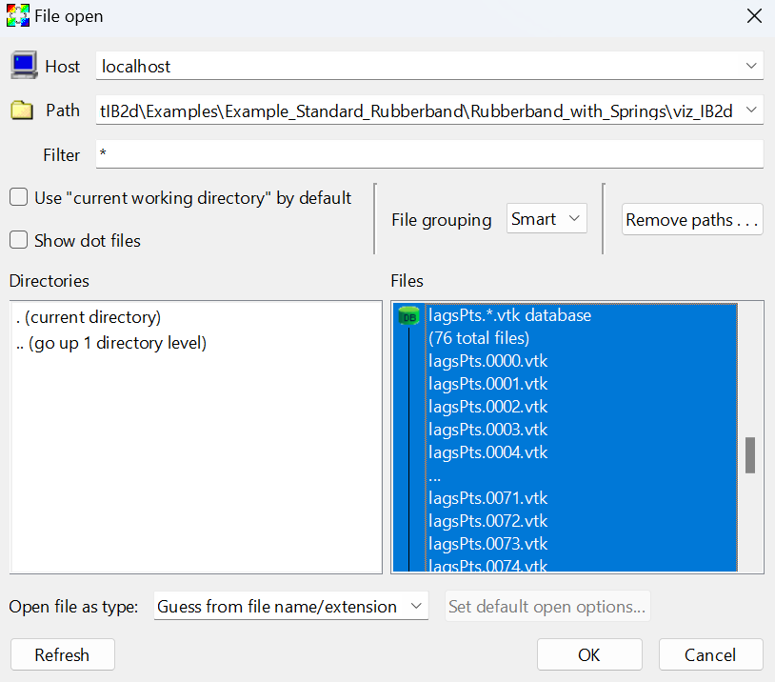
Open the boundary data
Now let’s begin throwing in our data! The first thing we need do open is the geometry files, i.e., the lagsPTs.*.vtk files. To do this click the open icon, and enter the directory pathway pointing to the sample data file.

Slide 14
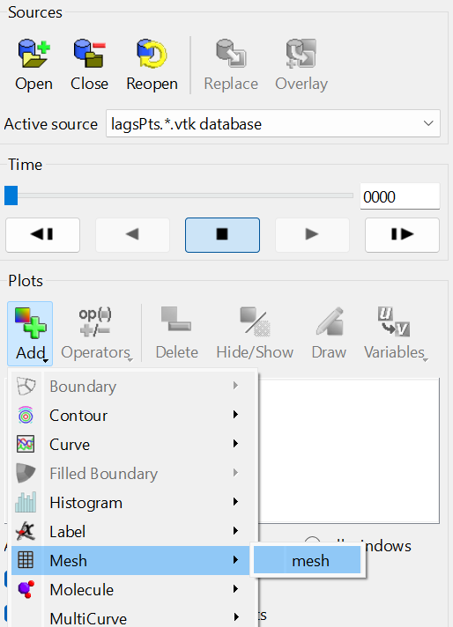
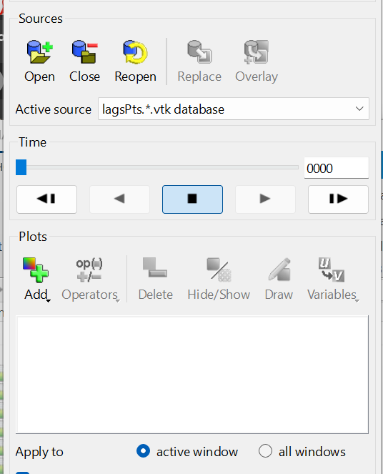
Open the boundary data
Once you click ok, it will return to what is a blank screen. All we did so far was open the file – we need to tell it to draw the Lagrangian points!
To do this first click the Add button and then click on mesh under the mesh option.

Slide 15
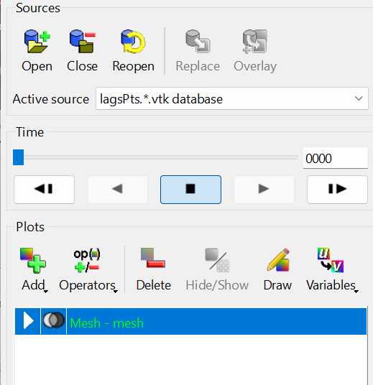
Plot the boundary
You will probably also notice that even though we opened the Lagrangian point file and added the mesh in Visit, nothing has shown up. Well now we will finally draw the geometry. To do this, just click on the mesh part and click on Draw.

Slide 16
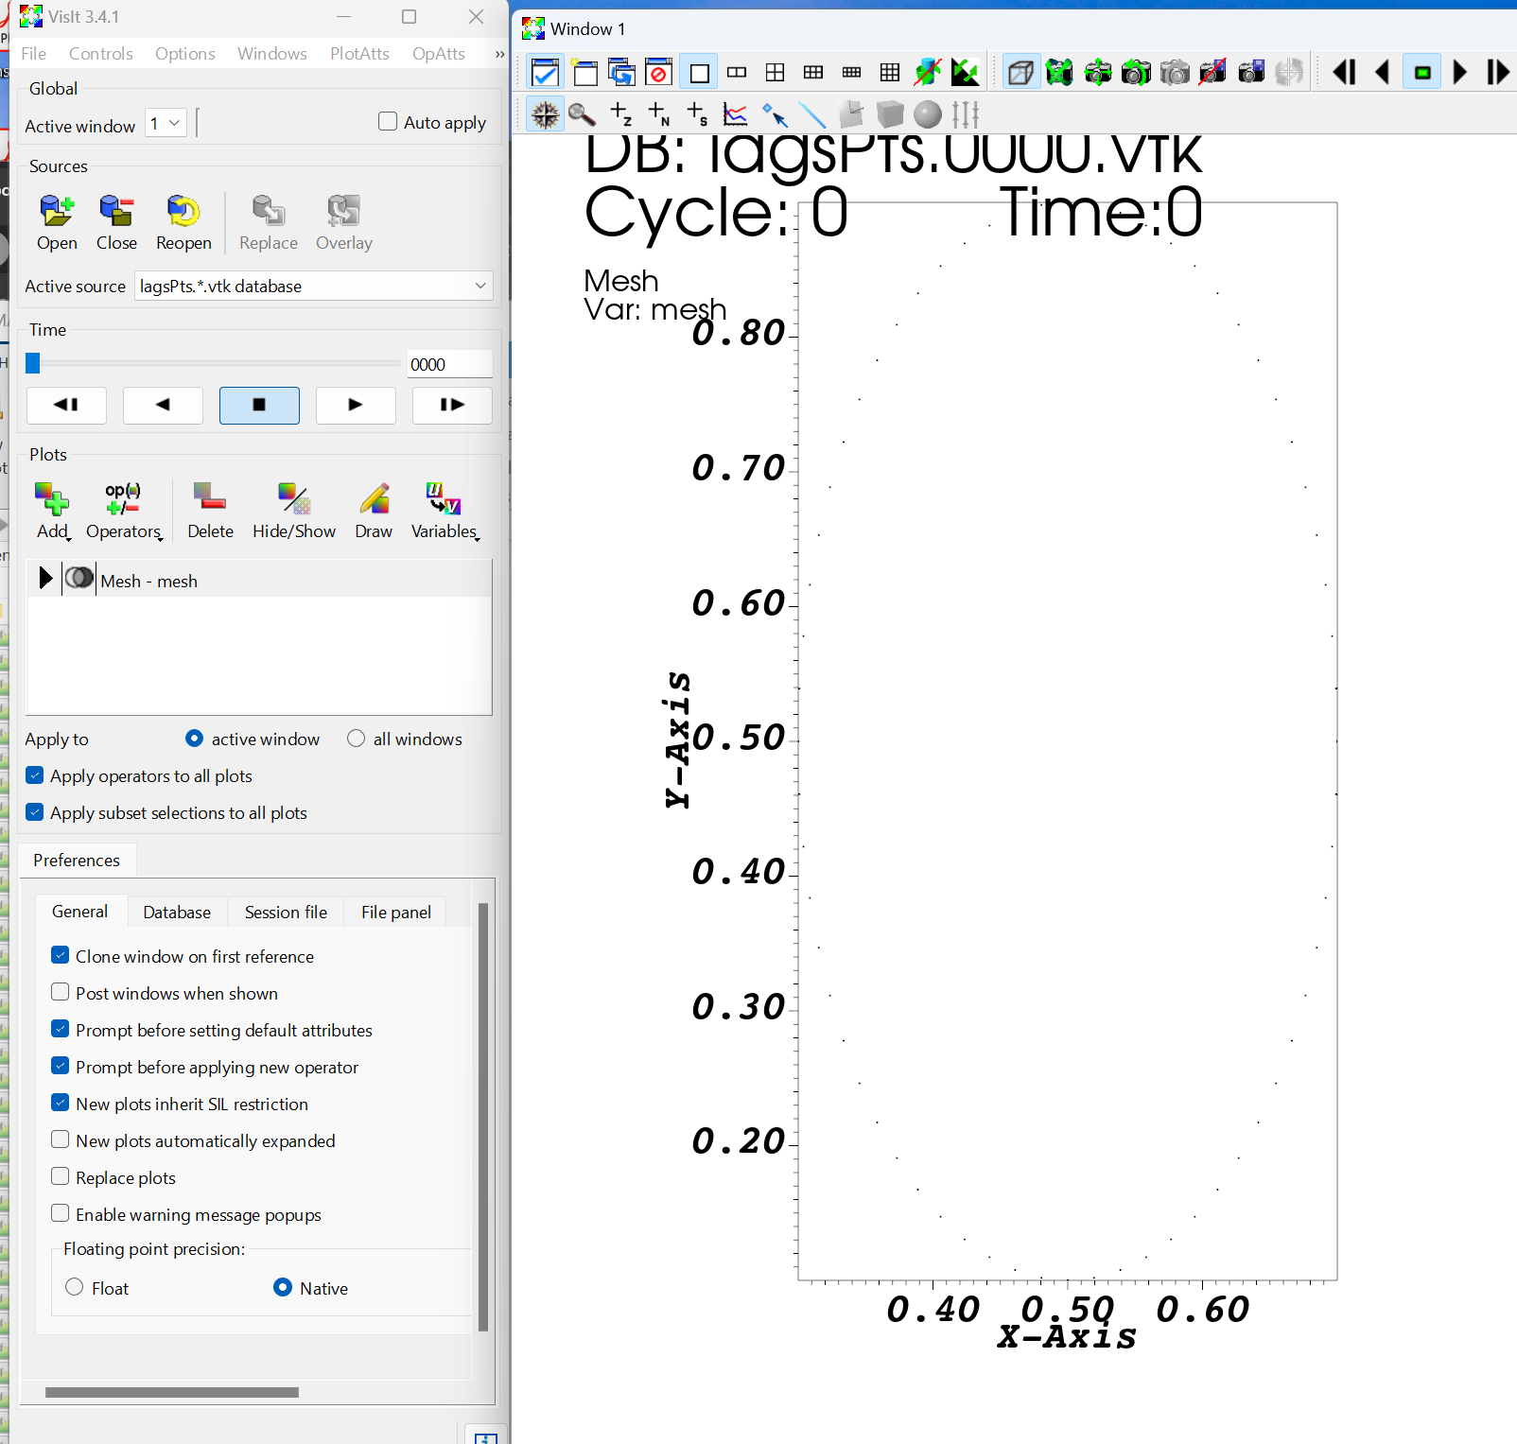
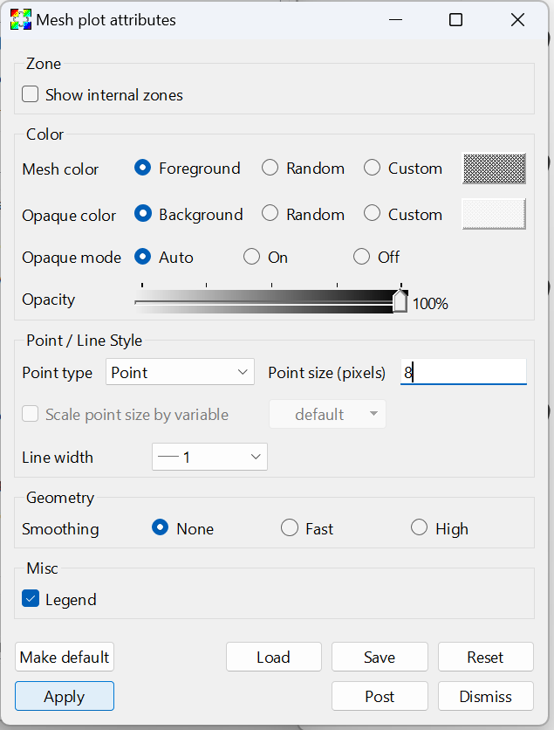
Now you should see the boundary
The vertices are small, so double click on Mesh - mesh. A window should pop up, and change the point size to 8 and hit apply.

Slide 17
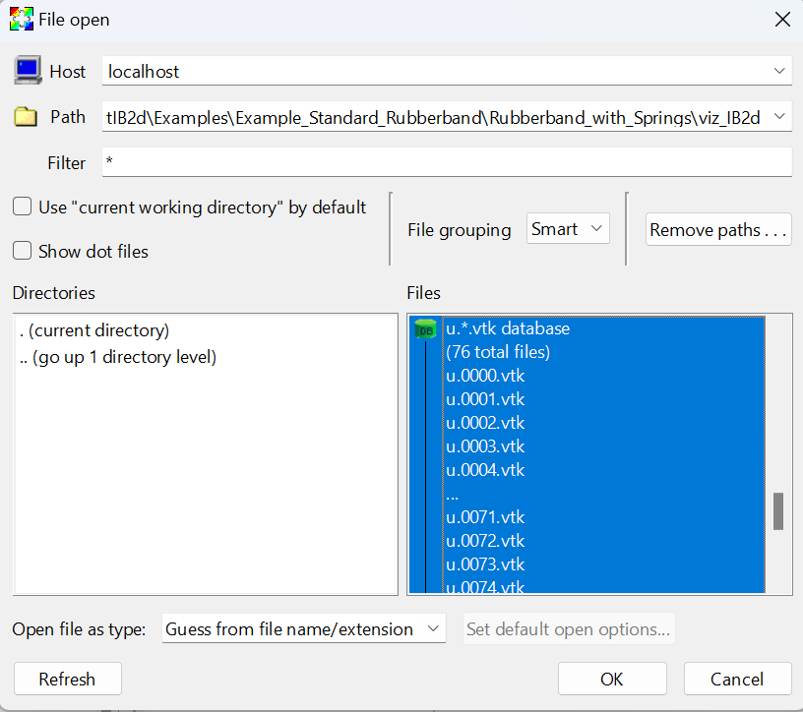
Open the velocity data
If you click open again, select the u.*.vtk data base and click ok.
Note that the vorticity (omega.*.vtk) and pressure (p.*.vtk) databases are also available.

Slide 18
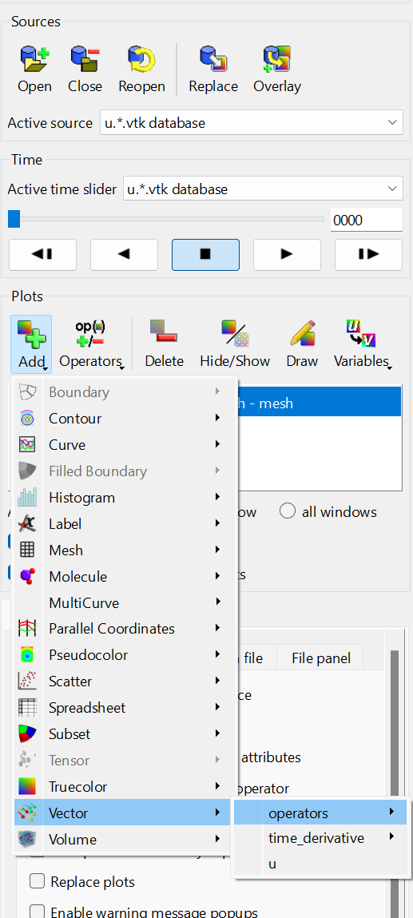
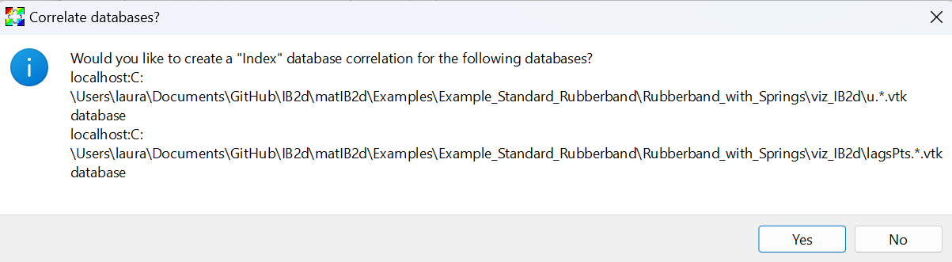
Plot velocity vectors
To display the velocity field, click Add -> Vector -> u.
You will be asked if you want to create and “Index” database correlation for the databases. Click Yes, this will allow both the vertices and velocity field to advance in time together.
Click Draw.

Slide 19
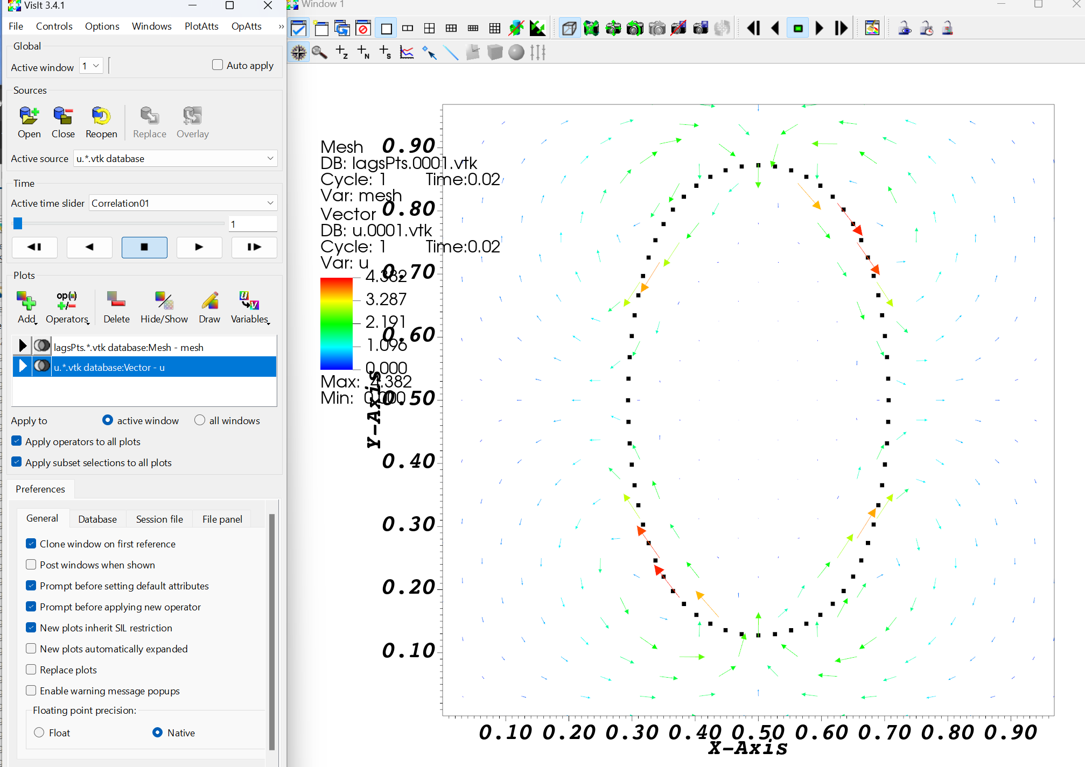
Advance to the next time
You won’t see anything at this point because the velocity field is zero.
Click the arrows to advance to subsequent times.
Click the camera with the green X to reset the view and see the whole flow field.

Slide 20
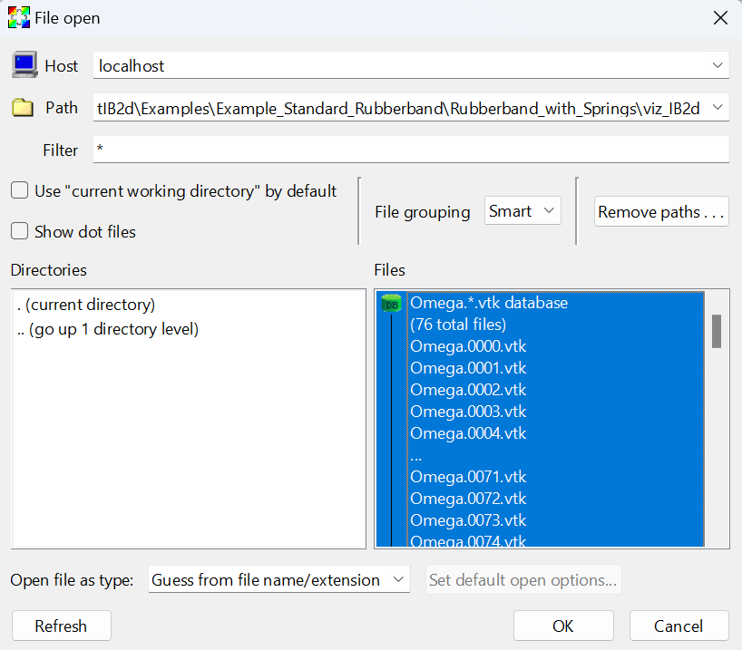
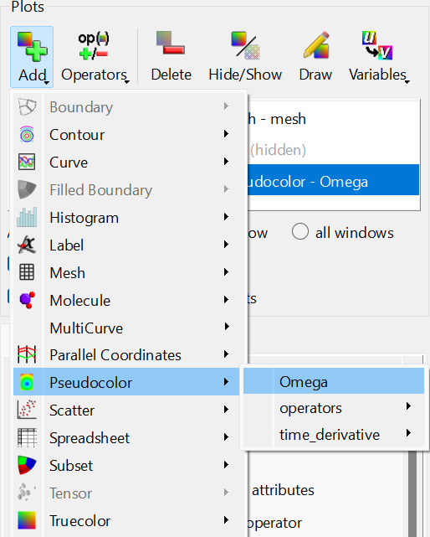
Plot the vorticity
Make sure that u.*.vtk is highlighted, and then click Hide/Show
We will open the vorticity data and plot a color-map for each time-step.
Click Open and then select Omega.*.vtk database
Click on Add and hover over Pseudocolor and click on Omega for the vorticity colormap.

Slide 21
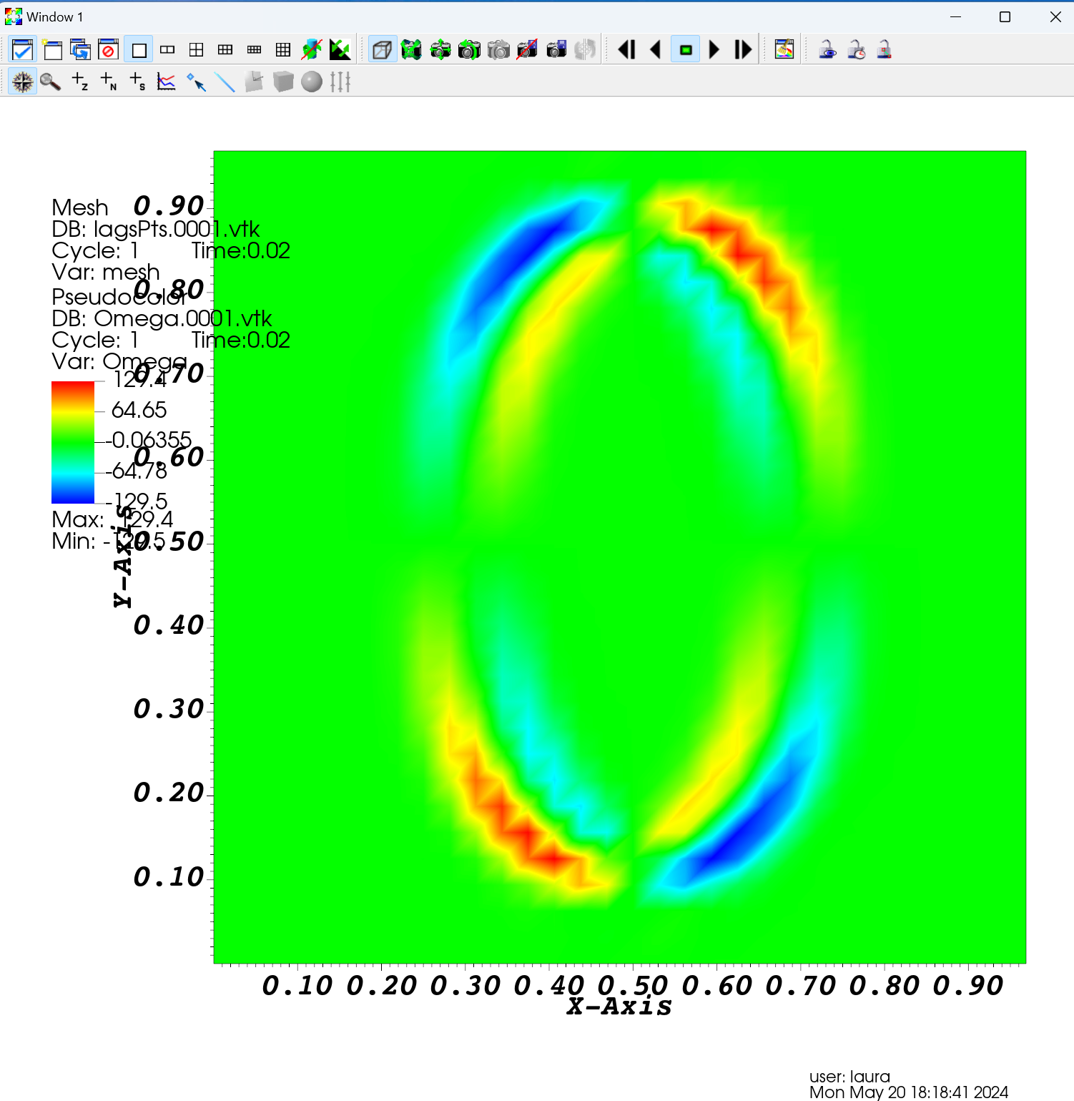
Vorticity plot
Click on Draw
You might notice the vertices have disappeared. Visit makes plots on top of plots, so the pseudocolor plot is obscuring the vertices.
Change the Active source to LagsPts.*.vtk
Click Add->Mesh->mesh and Draw.
Resize the mesh as appropriate.

Slide 22
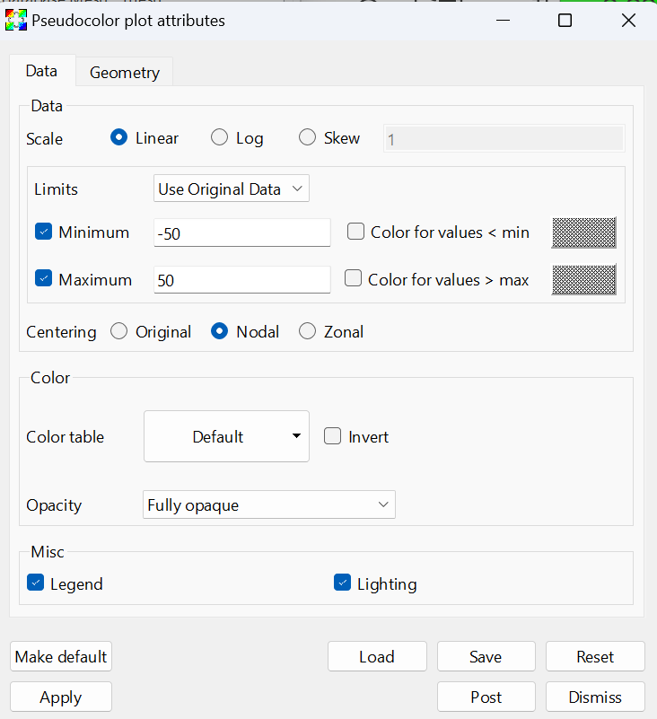
Customize vorticity
To customize the vorticity color-map, double-click on Omega.*.vtk. We will now change a few features in the window that opens.
Change Minimum and Maximum values to -50 and 50, respectively. These are just approximate values, you can change them to see how the colormap is affected. Basically it says if vorticity is ever higher than 50 or less than -50, the colormap only goes up to 50 or -50 as the highest and lowest values.
Click the Nodal option – this should reduce the amount of noisiness around the boundaries a little.
Change the Opacity to 70% (or don’t change it). Reducing the Opacity from 100% to something less helps see the velocity vectors better.

Slide 23
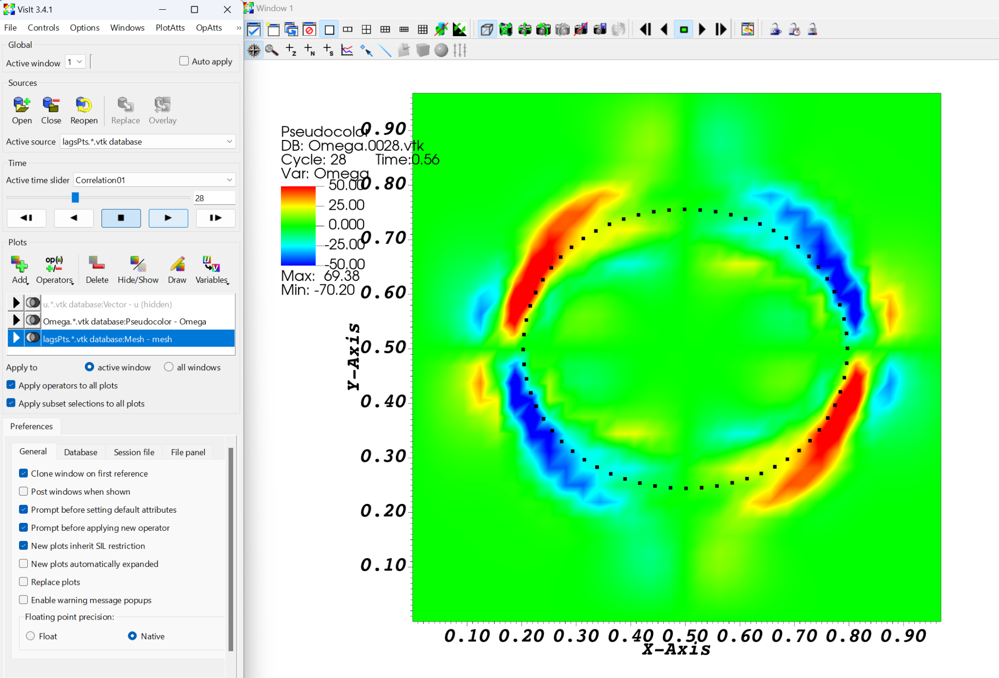
Play the simulation
Now press the Play button and watch the simulation! You should see the rubberband bounding with the formation of new vortices during each bounce.
Note that the other color-maps have similar options you can do. I also want to stress that these are just general guidelines to follow, but are in no way the best chosen values to visualize the data. Play around and try things!
Play button

Slide 24
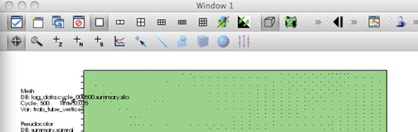
Zoom
You can now watch the simulation by clicking Play. There are many other customizations you can do – this is just the beginning! One thing you might want to do is zoom into the region of interest – namely that around the channel and cavities. To do this just click on the magnifying glass above the geometry window and drag a box over the region of interest and it will zoom in!
Reset the window back to the default window
To zoom into a region you drag your cursor around
Notes:
Reset the window back to the default window

Slide 25
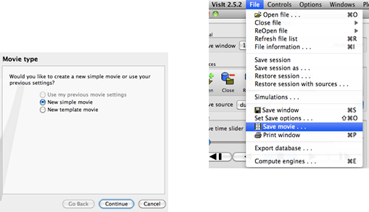
Make a movie
Let’s now talk about saving a movie. To do this go to the File and click on Save Movie. This will bring up another dialog box. At the first screen you will click New simple movie and then click Continue.

Slide 26
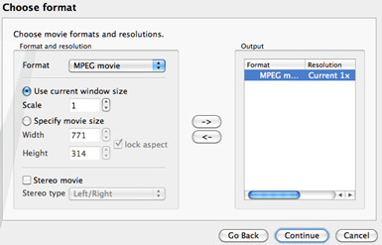
Make a movie
At the next screen we will choose the format to be MPEG Movie and then click the Right arrow, -> , and then click Continue.

Slide 27
Save the movie
Now at the next screen, we have the options of telling it to begin saving the movie at a specific frame, ending at a specific frame, picking the frame rate, and the frame stride (if you want to make a movie out of every other frame, every 5, etc)
Next we can choose what folder the movie gets saved to, as well as you can title the movie.

Slide 28
Suggested Exercises: change the initial rubberband
Change the rubber band in the rubberband example such that it is stretched in the y-direction. Make the deformation enough that you can see it.
Change the viscosity in the input2d file to make the rubberband in a very viscous fluid.

Slide 29
How do I move the boundaries?
You can make boundaries actively move using
Target points to provide a preferred motion
Springs whose stiffness or resting lengths change in time
Beams whose resting curvature changes in time
Muscle models / muscle springs
This is typically done by making an update_XXX.m file.

Slide 30
Swimming fish example
** This example will take about 15-20 mins to get to time 1
Now we will look at an example of a swimming fish (which has been modeled as a beam that changes its curvature to swim).
This is a more complicated example, and it will take longer to run. You might want to try to simulate a few times and then cancel the run.
Go to matIB2d/Examples/Examples_First_Year_Seminar/Swimmer
In the command window, type
>main2d
When you want to stop the simulation, type Ctrl+C

Slide 31
Associated files
main2d is the function that gets called to run the code. It itself, reads in parameters from the input2d file, and passes them to the IBM_Driver function to run the simulation
Swimmer_Geometry.m creates the swimmer.* files.
input2d is where you set the physical parameters (density, viscosity, etc) grid size, temporal information, which elastic models are used, etc.
update_nonInv_Beams.m is used during the simulation to change the preferred curvature of the beam.

Slide 32
Associated files
swimmer.phases stores the preferred curvature of the swimmer over a cycle.
test_Script.m reads in swimmer.phases and displays the motion.
If you want to see the motion that the swimmer will use, then type test_Script in the command window.

Slide 33
update_nonInv_Beams
%%%%%%%%%%%%%%%%%%%%%%%%%%%%%%%%%%%%%%%%%%%%%%%%%%%%%%%%%%%%%%%%%%%%%
%
% FUNCTION: updates the beam attributes!
%
%%%%%%%%%%%%%%%%%%%%%%%%%%%%%%%%%%%%%%%%%%%%%%%%%%%%%%%%%%%%%%%%%%%%%
function beams_info = update_nonInv_Beams(dt,current_time,beams_info)
% beams_info: col 1: 1ST PT.
% col 2: MIDDLE PT. (where force is exerted)
% col 3: 3RD PT.
% col 4: beam stiffness
% col 5: x-curvature
% col 6: y-curvature
%IDs = beams_info(:,1); % Gives Middle Pt.
% Coefficients for Polynomial Phase-Interpolation
a = 2.739726027397260; % y1(t) = at^2
b = 2.739726027397260; % y3(t) = -b(t-1)^2+1
c = -2.029426686960933; % y2(t) = ct^3 + dt^2 + gt + h
d = 3.044140030441400;
g = -0.015220700152207;
h = 0.000253678335870;
% Period Info
tP1 = 0.25; % Down-stroke
tP2 = 0.25; % Up-stroke
period = tP1+tP2; % Period
t = rem(current_time,period); % Current time in simulation ( 'modular arithmetic to get time in period')
Reads in the swimmer.phases, interpolates between the two time points in the phase, updates the preferred curvature along the length of the beam.

Slide 34
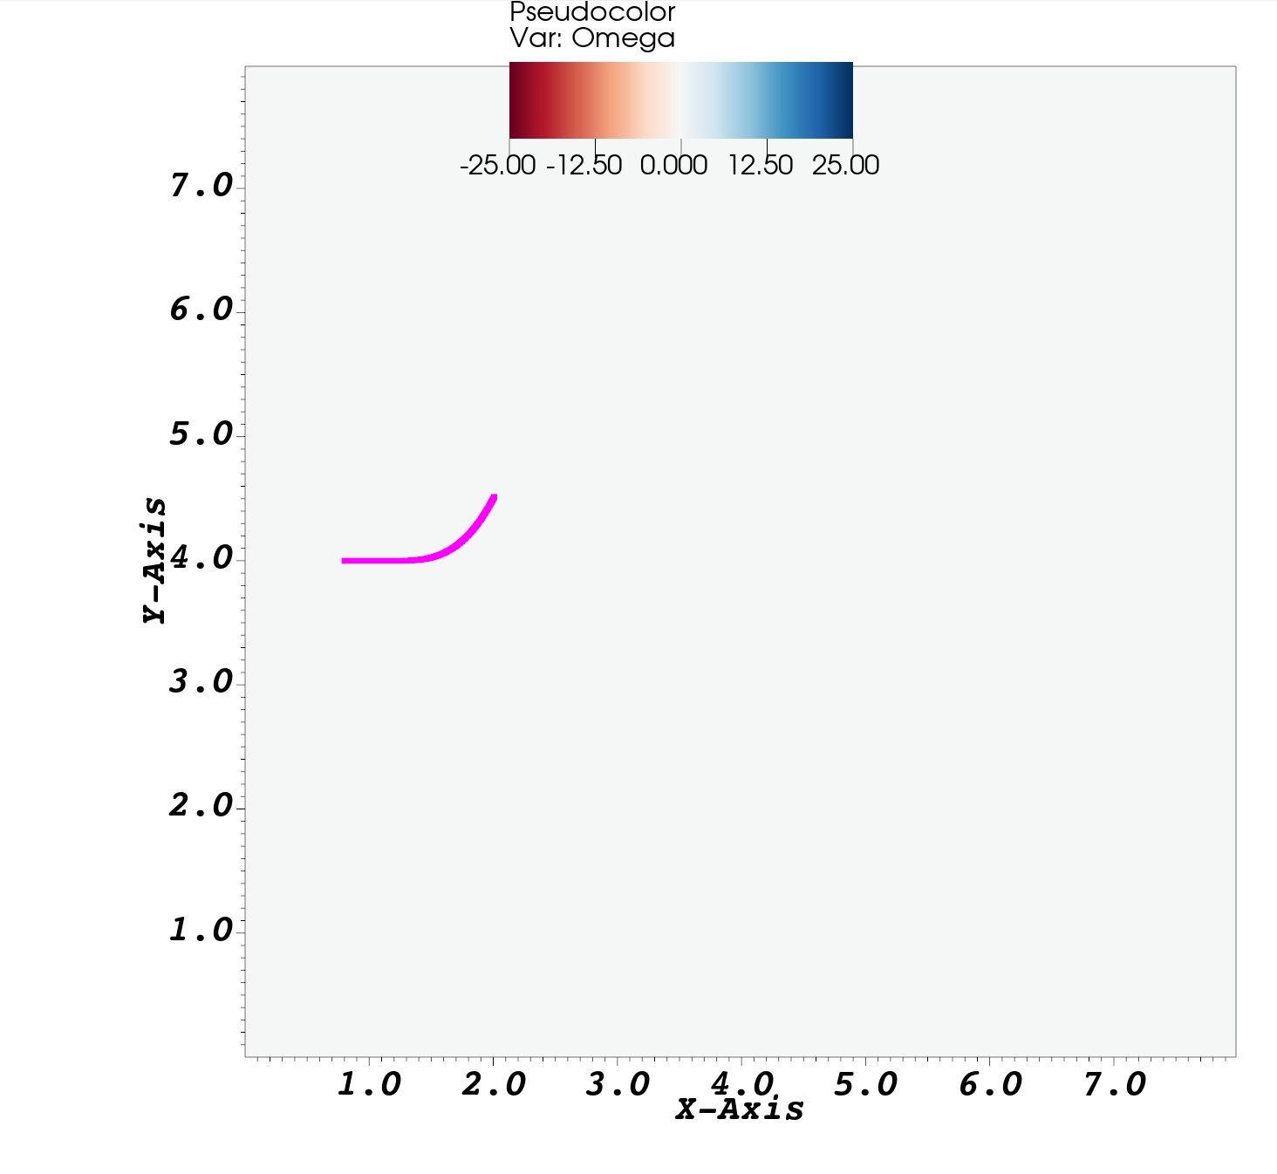
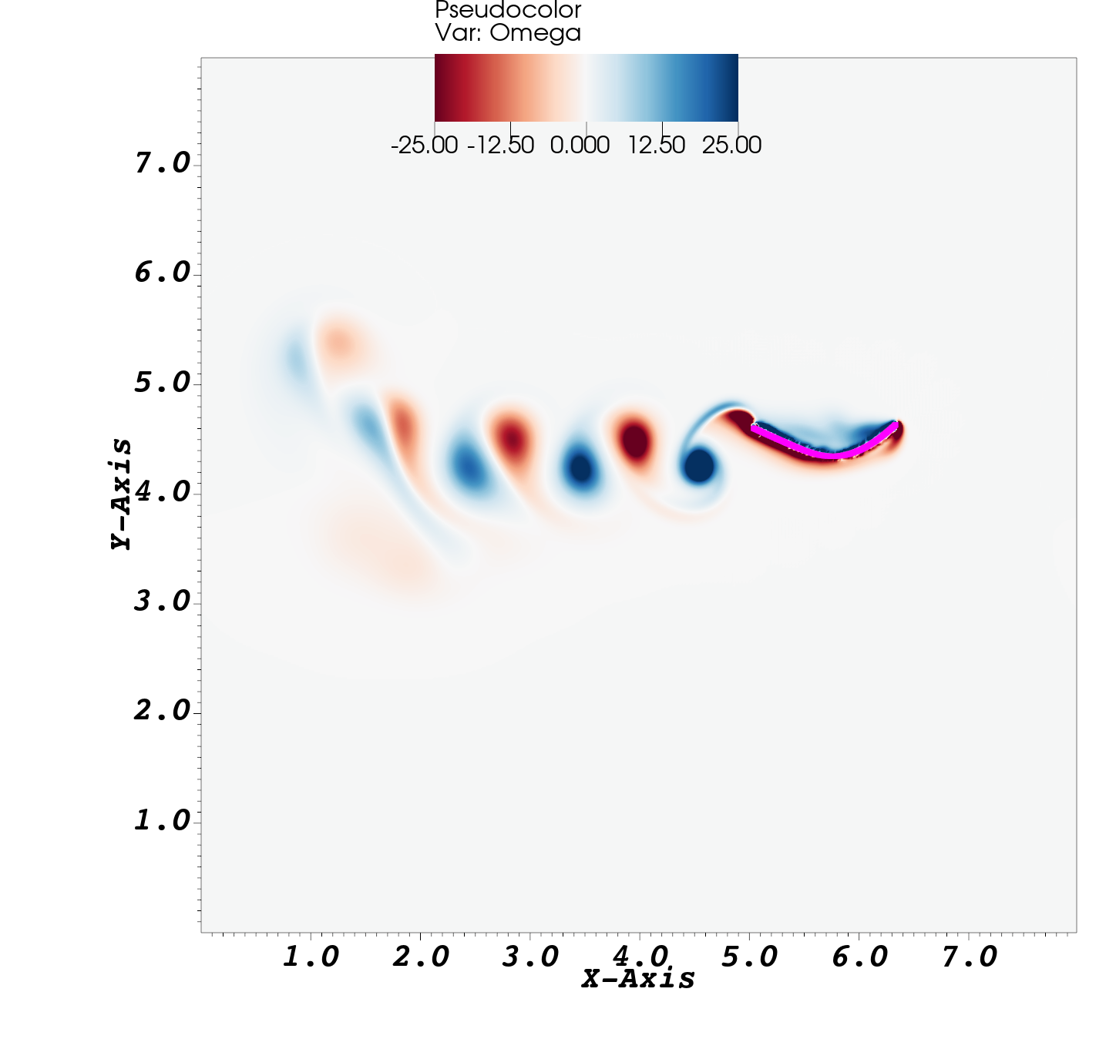
Start and end of simulation

Slide 35
Leaf example
Now we will look at an example of a leaf that is releasing heat in a background flow.
This is a more complicated example, and it will take longer to run. You might want to try to simulate a few times and then cancel the run.
Go to matIB2d/Examples/Examples_Concentration_Dynamics/Leaf_64
In the command window, type
>main2d
When you want to stop the simulation, type Ctrl+C

Slide 36
Leaf example
Now we will look at an example of a leaf that is moving in a background flow that is releasing oxygen.
This example has a cylinder (stem) that is held fixed and a line (leaf) coming off it.
The model includes vertex points, springs, beams, mass and a concentration from the leaf.

Slide 37
Associated files
main2d is the function that gets called to run the code. It itself, reads in parameters from the input2d file, and passes them to the IBM_Driver function to run the simulation
Leaf_Leaf.m creates the leaf.* files.
input2d is where you set the physical parameters (density, viscosity, etc) grid size, temporal information, which elastic models are used, etc.
please_compute_external_forcing.m is used during the simulation to set the background flow on the left hand side of the domain

Slide 38
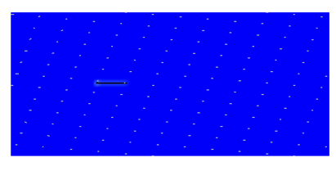
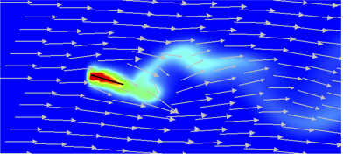
Start and end of simulation

